Slide 1
LEVEL 4/5 GROUP 10
THOMAS MCLAREN
JAMIE OWERS
EDUARD IABLONSCHI
EDWARD PHILLIPS

Slide 2
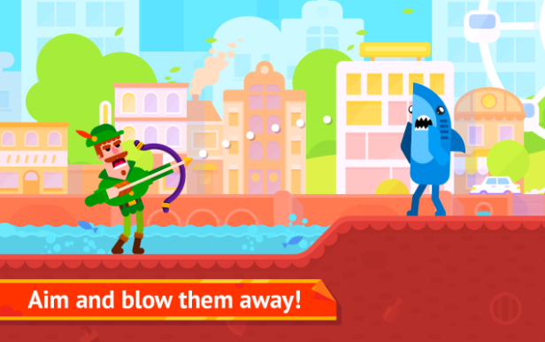
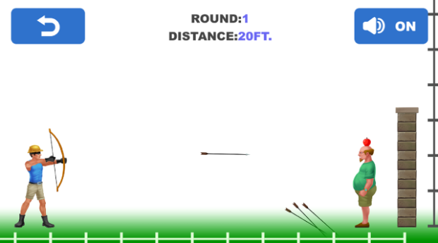
GENRE / STYLE
2D Action game
Mobile only
Competitive 2 player
Notes:
Tom McLaren slide

Slide 3
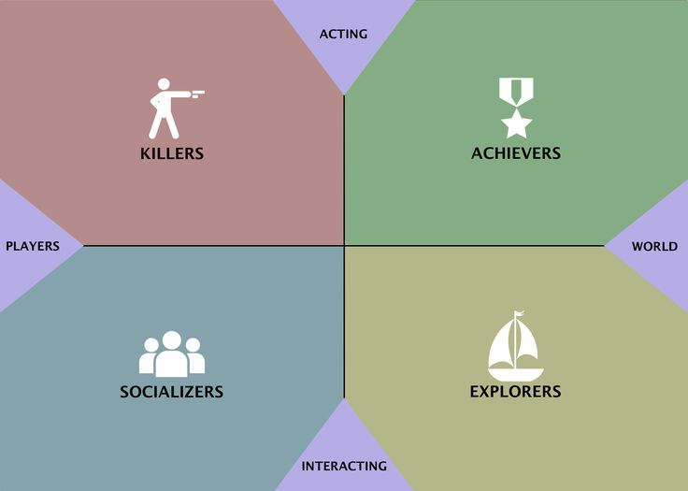
TARGET DEMOGRAPHIC
Socializers
+ Killers
Age:
12+
Gender:
Males & females
Notes:
Jamie Owers Slide

Slide 4
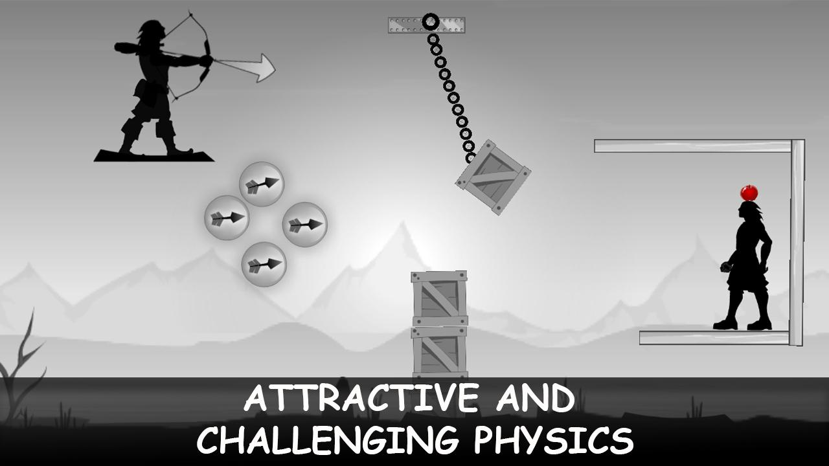
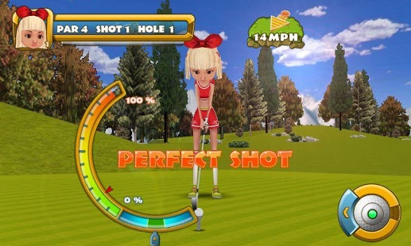
MECHANICS
Symmetric mechanic – Aiming & power selection
Damage – (hit by projectile)
Health - Hearts
Notes:
Eduard Iablonschi Slide

Slide 5
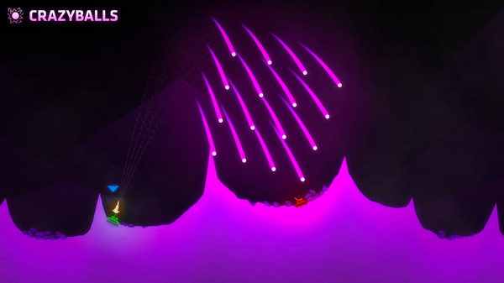
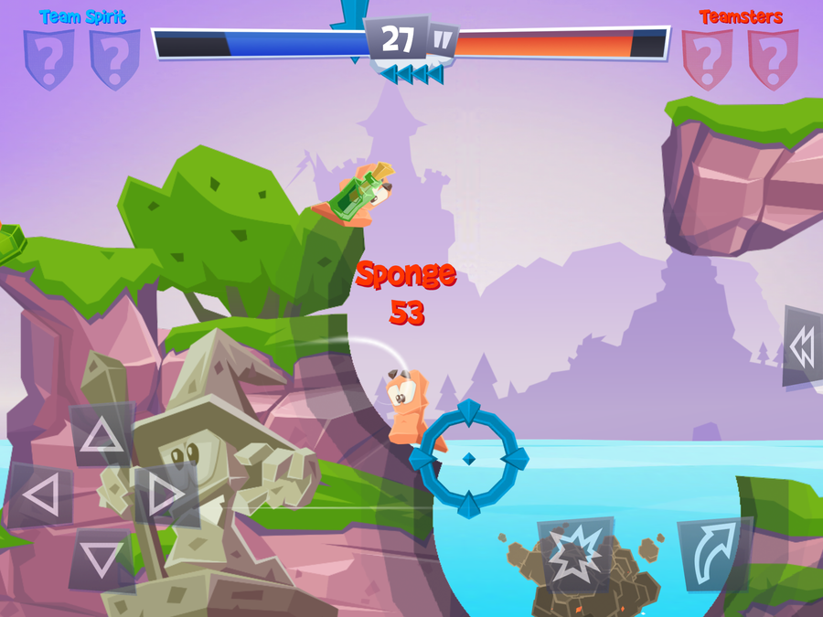
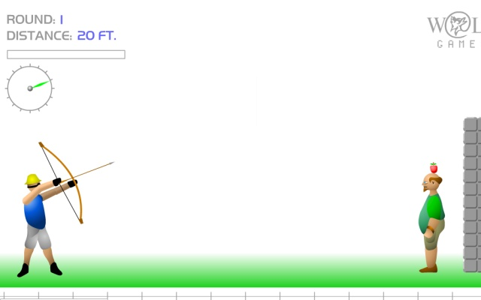
Inspired Examples
ShellShock Live
Shoot The Apple
Worms
Notes:
Tom McLaren Slide

Slide 6
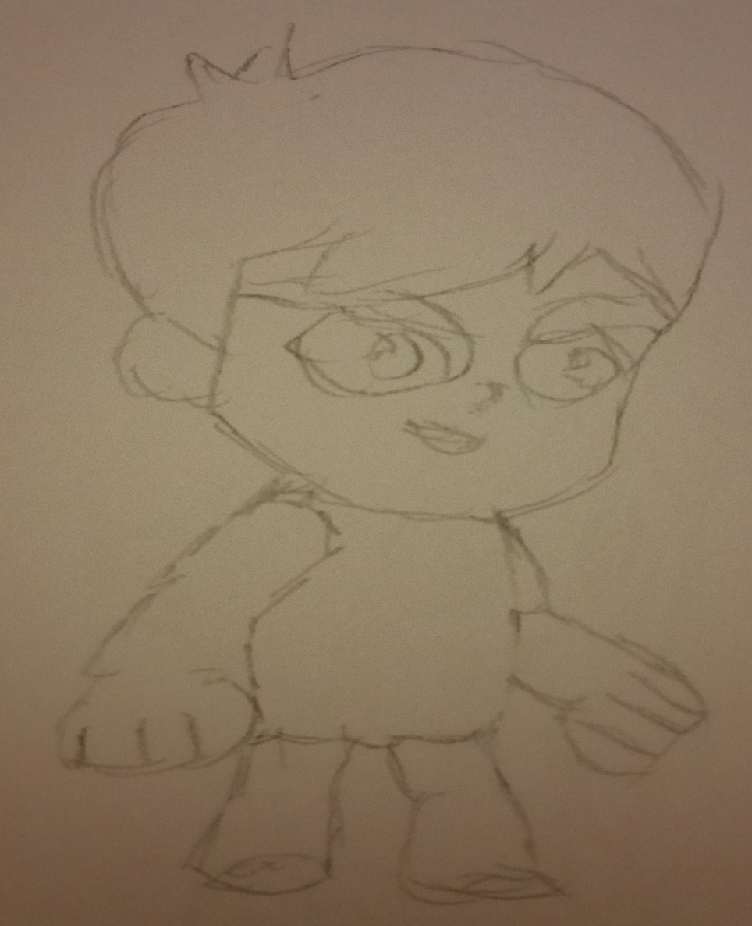
WHAT DOES THE PLAYER DO?
Button press
Competitive - goal
Reflex - selecting trajectory & power
Fiero
Notes:
Tom McLaren Slide

Slide 7
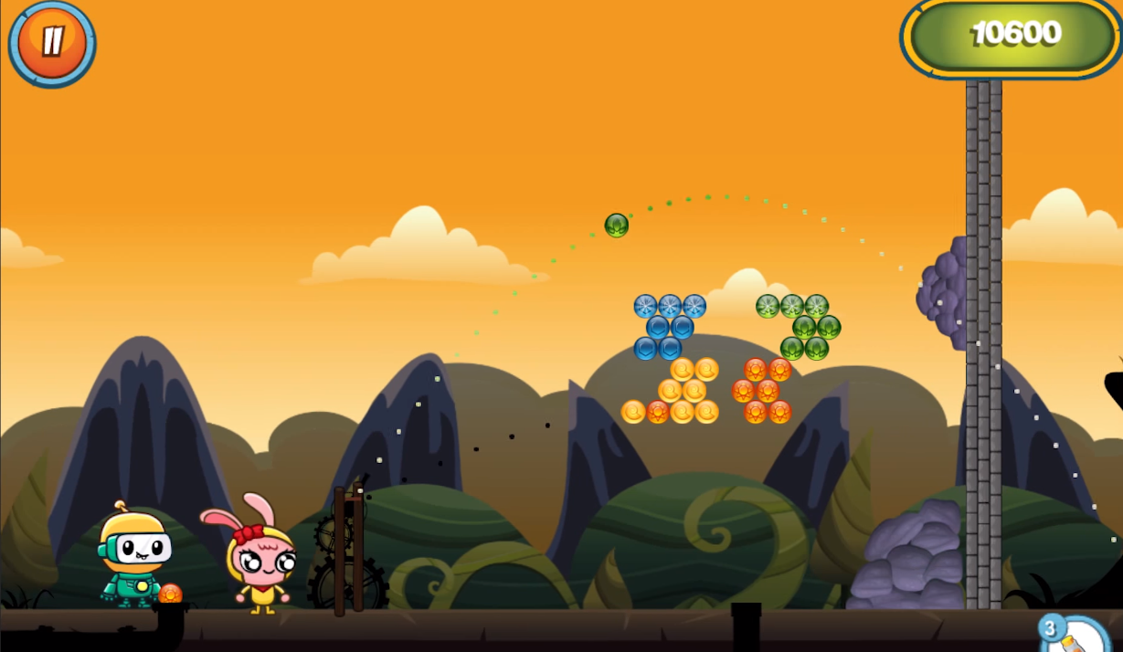
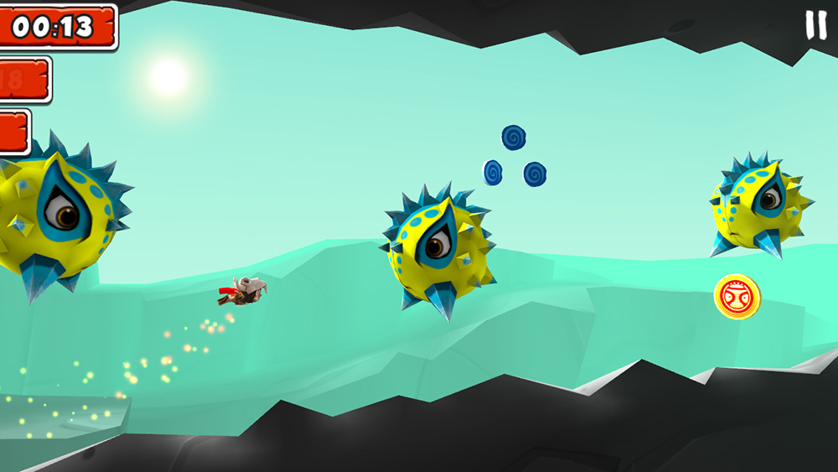
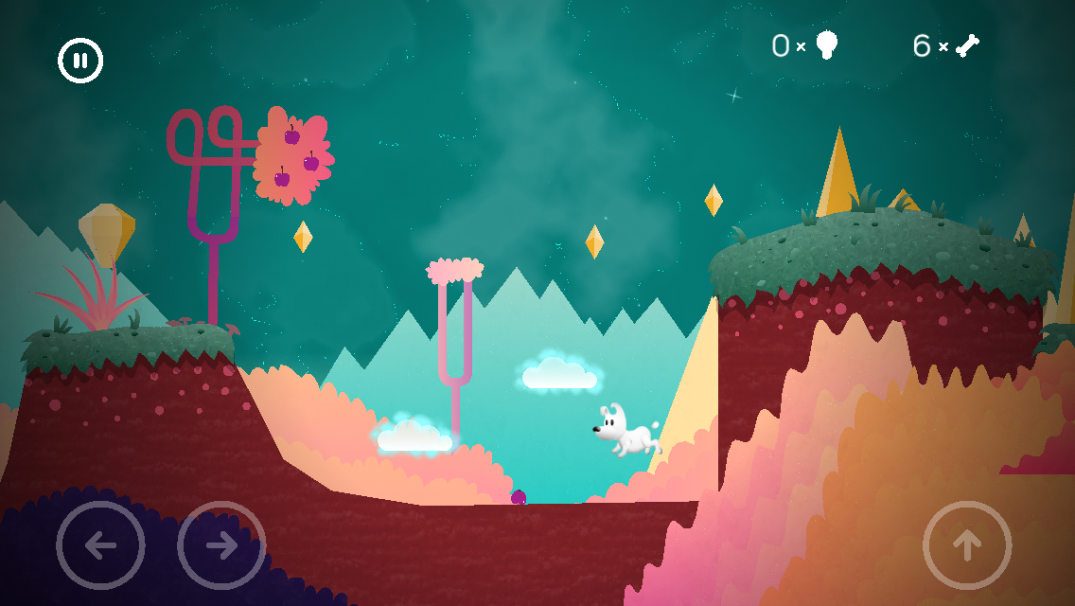
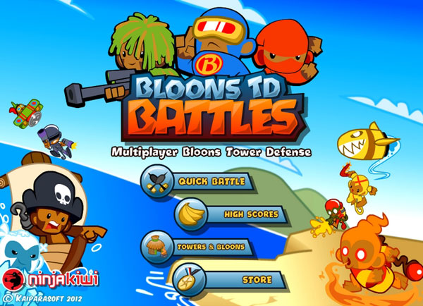
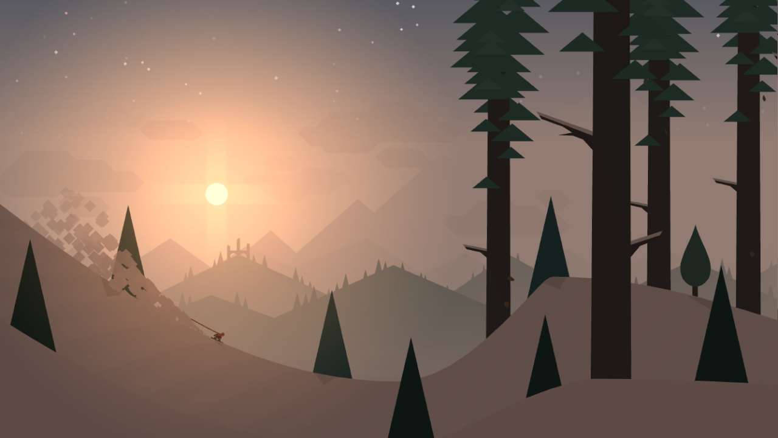
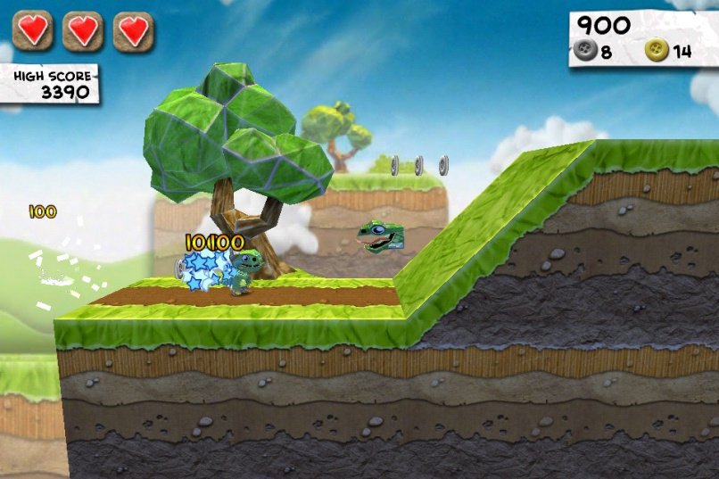
ART STYLE
Notes:
Edward Phillips Slide

Slide 8
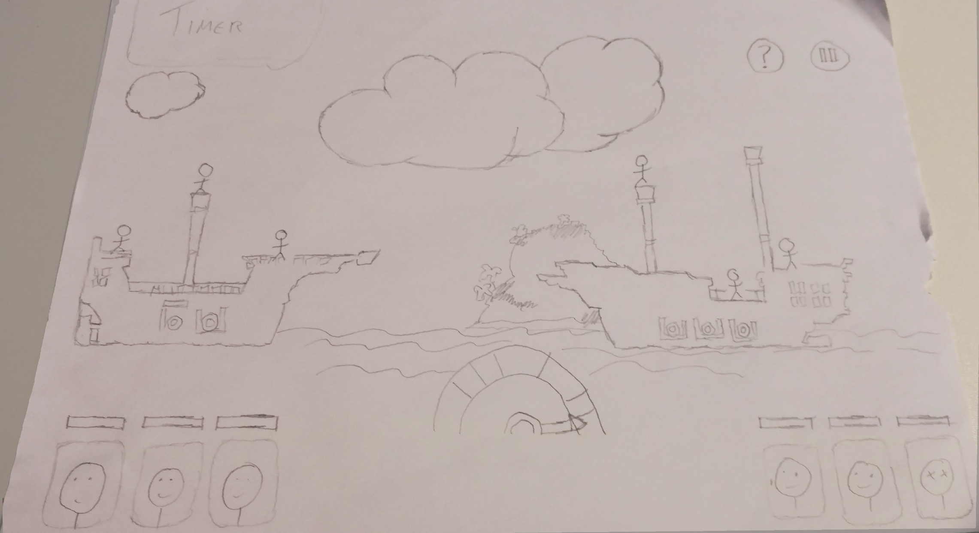
VISUAL HIERARCHY
Notes:
Tom McLaren Slide

Slide 9
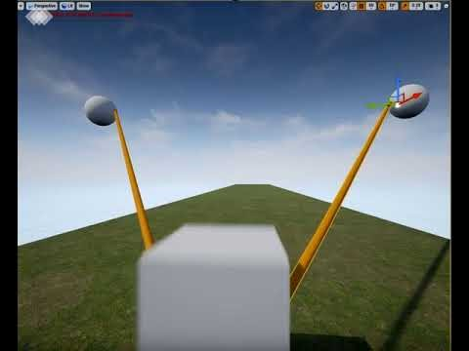
PROTOTYPE

Slide 10
TARGETS FOR NEXT WEEK
Achieve a 2d projectile mechanic & power selection in UE4
Create concept art for characters & game background using feedback from our target demographic

Slide 11

ANY QUESTIONS?

